Slide 1


Impact of COVID-19 On a Macroeconomics
Presenter: Yichun Zhou
Radhika Kalyan Kerur
Vidhi J Sanghvi
Ray Zhao
Yunxin Chen
Data Engineering
Spring 2020
‹#›

Slide 2
Agenda
Current situation
Gapminder video about COVID-19 emerging in countries
Data sources
Clustering: k-Means clustering and Hierarchical clustering
Compression/sanity checks
The countries we choose and basic statistics
Prediction Models comparison: LR, ARIMA & FB Prophet
FB Prophet selected and the reasons
FB Prophet graphs for the rest of the countries
Final conclusions
‹#›

Slide 3
Current Situation
The outburst of coronavirus named COVID-19 has disrupted the global Macroeconomics.
The spread of COVID-19 and its economic impact is highly unresolved which increase the difficulties for policymakers to prepare an appropriate macroeconomic policy response.
31 January - US restricts entry
February 29 - first death in US
Today - US Coronavirus Cases:
1,307,430
30 January - Public Health Emergency declared
‹#›

Slide 4

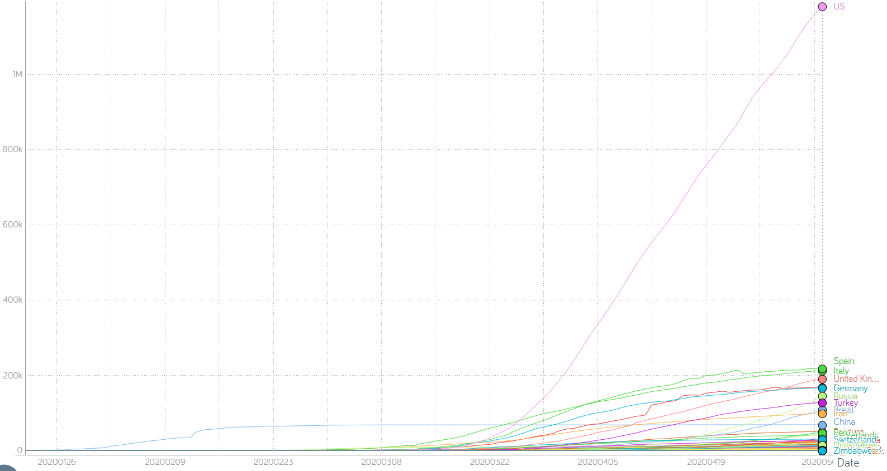
Total Confirmed Cases
*Data till May 5, 2020
‹#›
Notes:
Gapminder Video to be played - Ray

Slide 5
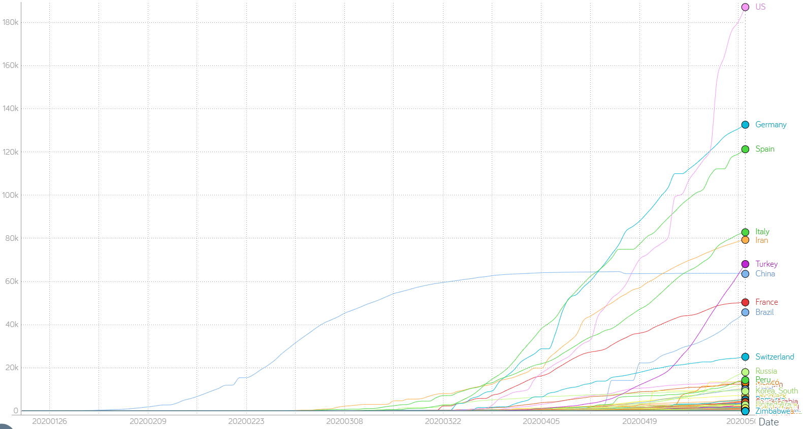
Total Recovered Cases
*Data till May 5, 2020
‹#›

Slide 6
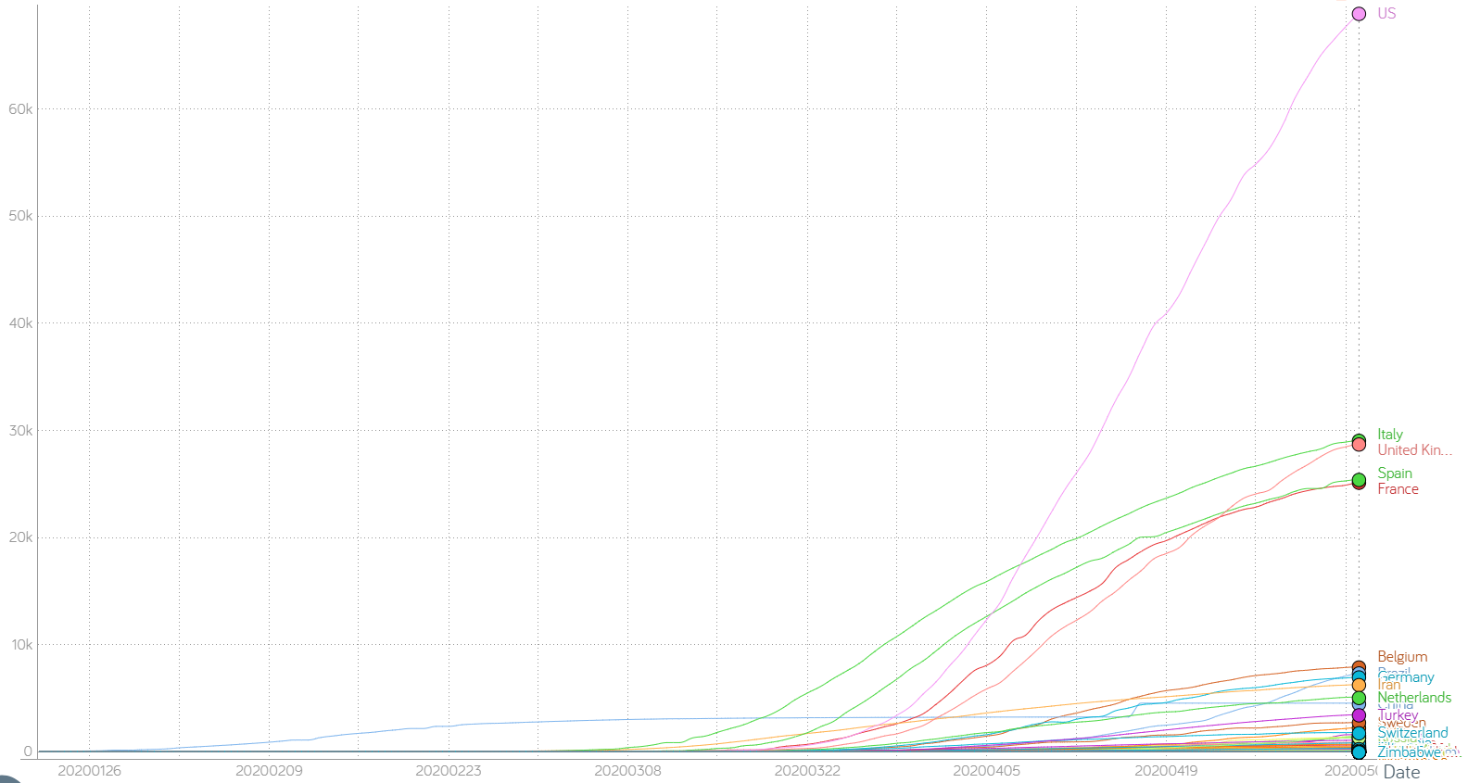
Total Death Cases
*Data till May 5, 2020
‹#›

Slide 7
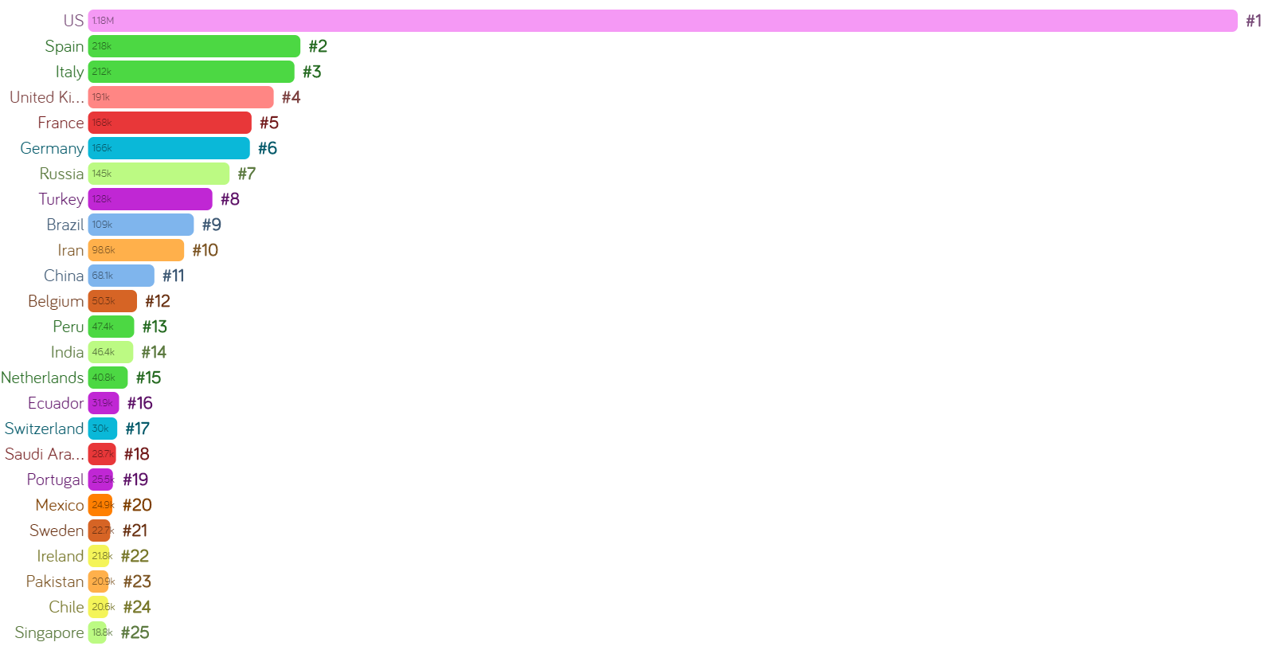
Ranking of Total Confirmed Cases
*Data till May 5, 2020
‹#›

Slide 8






Data Sources
Johns Hopkins - Covid-19 Data
Kaggle - Clustering the countries
Investing.com, World Bank- Unemployment - Time Series Data
BSE website - Stock indices - India
Yahoo Finance - Stock indices - US
‹#›

Slide 9
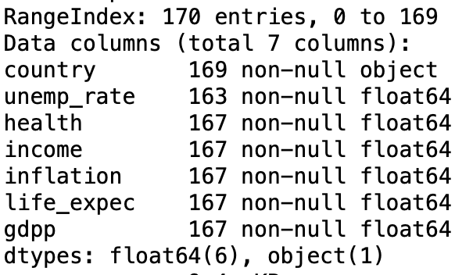
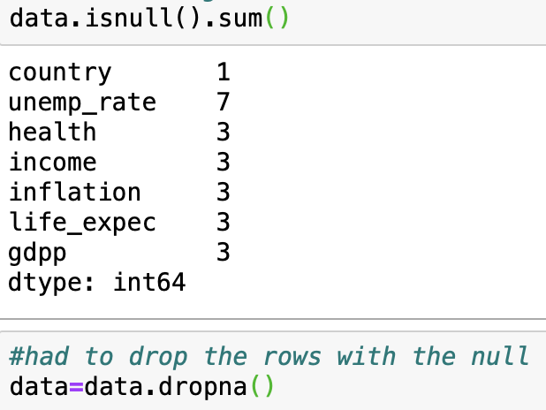
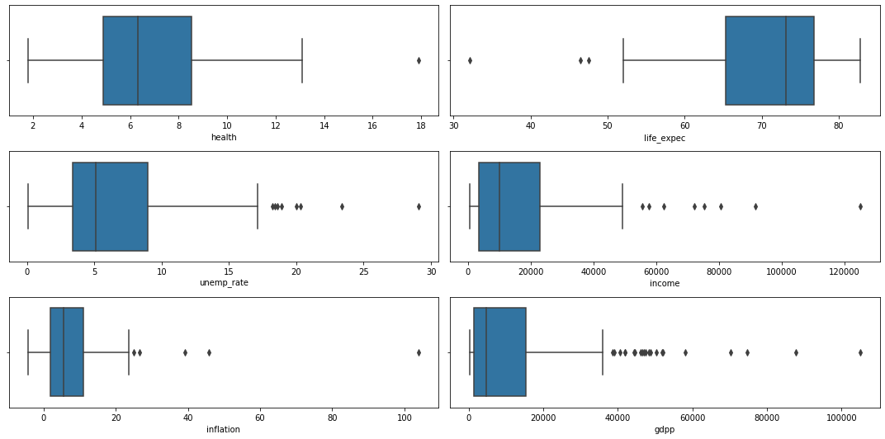
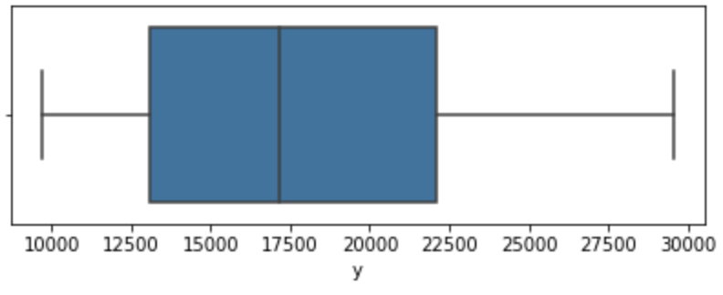
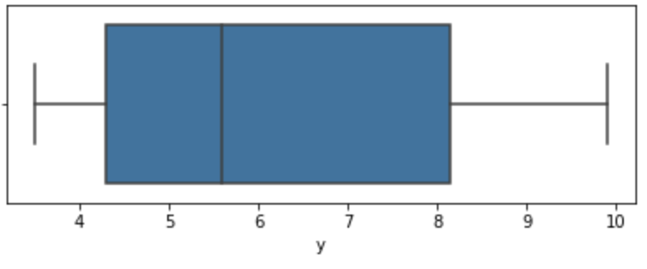
Data Sanity Checks (Filtering, Cleaning, Outlier Analysis)
Clustering Dataset
Prediction Model Dataset
No Missing Value or Outlier for unemployment and stock data
‹#›

Slide 10
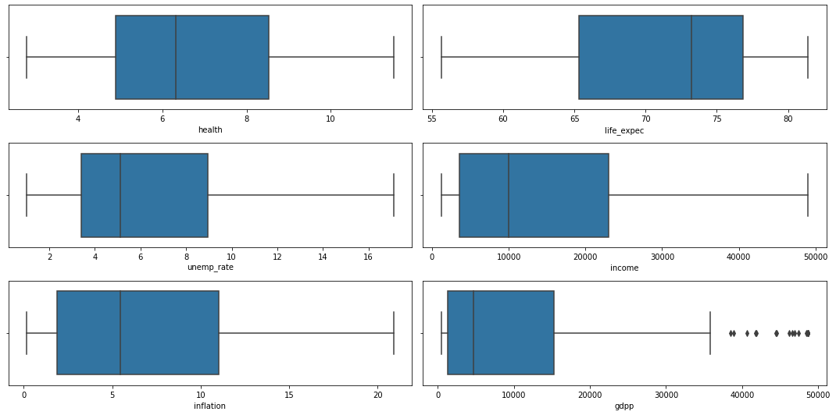
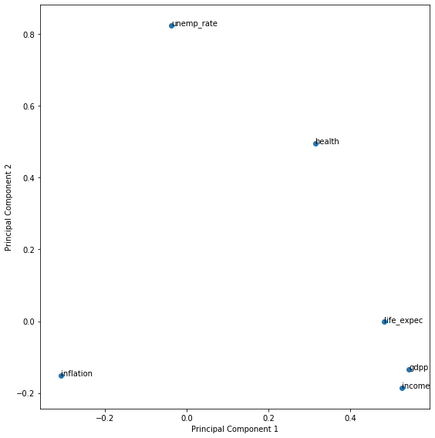
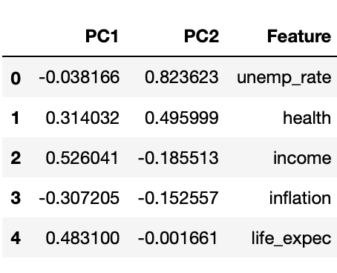
Data is now clean and ready to use!
Data Compression
PCA for Clustering Dataset
There is a different trend for every country And the difference of patterns (distance) is used
Compressed to 2
Principal Component Analysis
‹#›

Slide 11
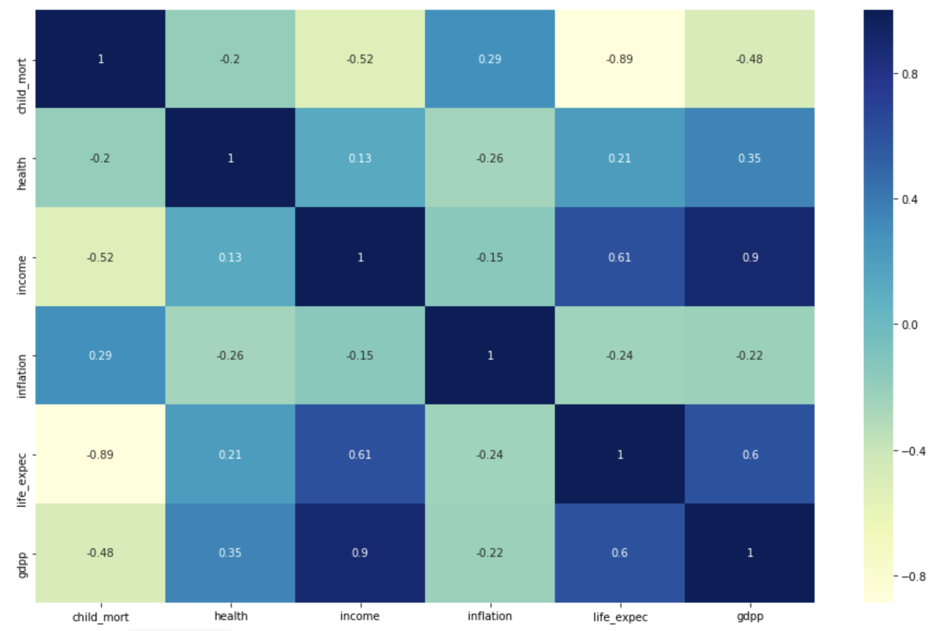
Correlation Matrix of Economic Factors
‹#›

Slide 12
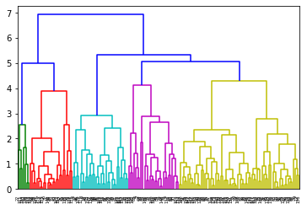
Clustering & Classification
k-Means clustering and Hierarchical Clustering
The Hopkins statistic : 0.7553218453255582, hence high tendency to cluster
Clustered the countries in 3 clusters
Used economic indicators like: GDP, Unemployment, Income, etc.
‹#›
Notes:
The Hopkins statistic, is a statistic which gives a value which indicates the cluster tendency, in other words: how well the data can be clustered.If the value is between {0.01, ...,0.3}, the data is regularly spaced. If the value is around 0.5, it is random.If the value is between {0.7, ..., 0.99}, it has a high tendency to cluster.

Slide 13
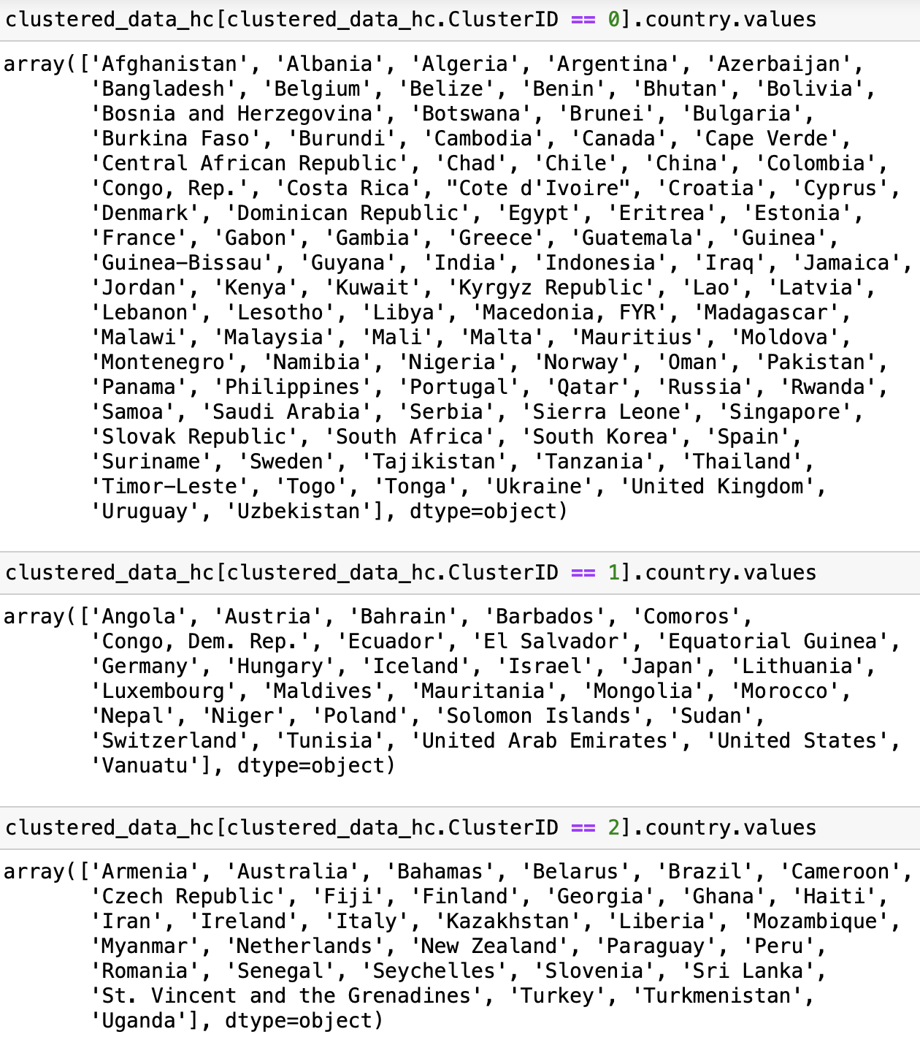
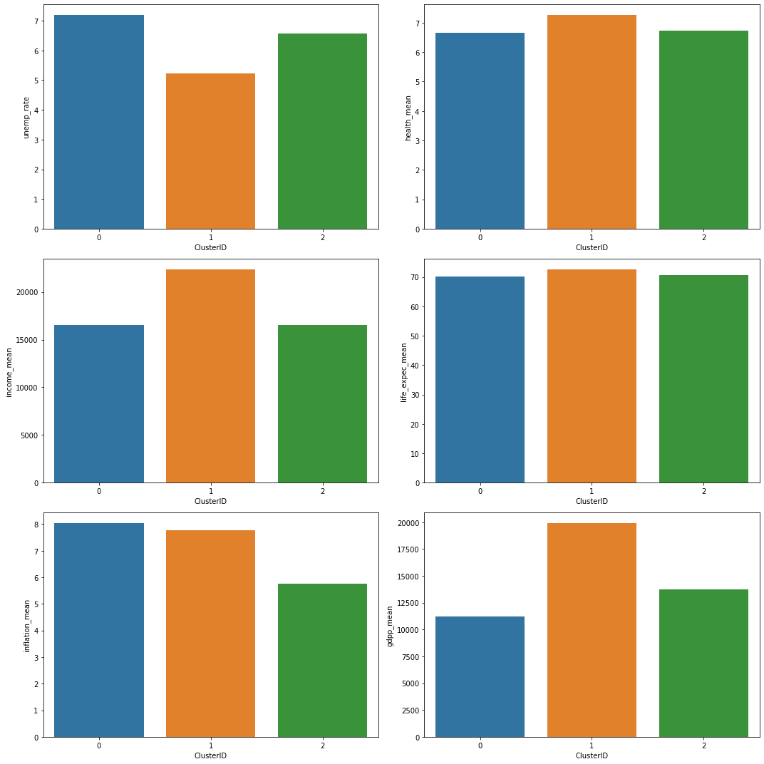
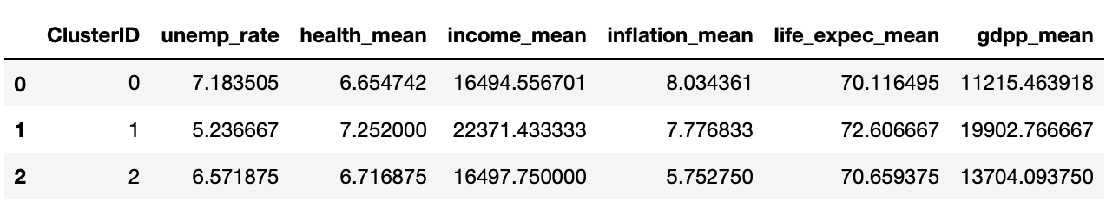
Clustering & Classification
‹#›

Slide 14
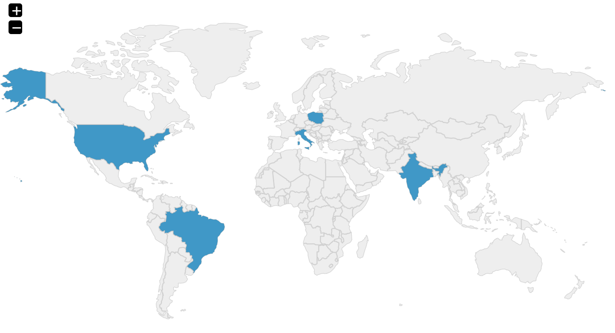
Countries we chose!
Cluster ID | Country | Characteristic
0 | India | High unemp, Low GDP
1 | Poland United States | Low unemp, High GDP
2 | Brazil Italy | Med unemp, Med GDP
POLAND
UNITED STATES
ITALY
INDIA
BRAZIL
‹#›

Slide 15
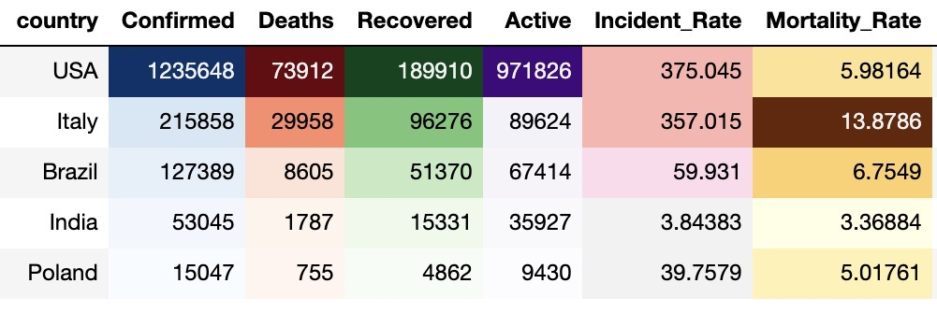
Basic Statistics - Selected Countries
Last Updated: May 7th, 2020
‹#›

Slide 16
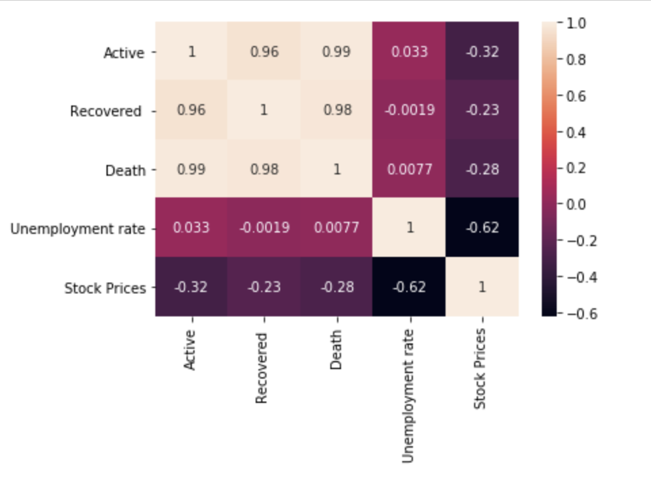
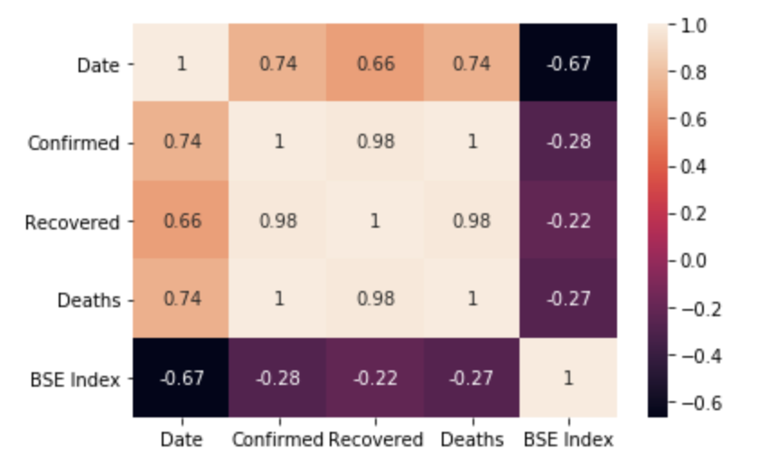
US Correlation Matrix
India Correlation Matrix
‹#›

Slide 17
Unemployment Rate Data - Model Comparison
Model | R Square | Mean Forecast Error | Bias | MSE
ARIMA | -0.20329847364 | 0.031572891133 | 0.031573 | 0.064176
FB Prophet | 0.96508326081 | 0.000161506343 | 0.00016 | 0.020953
Stock Index Data - Model Comparison
Model | R Square | Mean Forecast Error | Bias | MSE
Linear Regression | 0.96906996022 | -153.211198256 | -153.211198 | 31983.498993
FB Prophet | 0.97625893479 | 0.001802813885 | 0.0018 | 25158.449737
‹#›

Slide 18
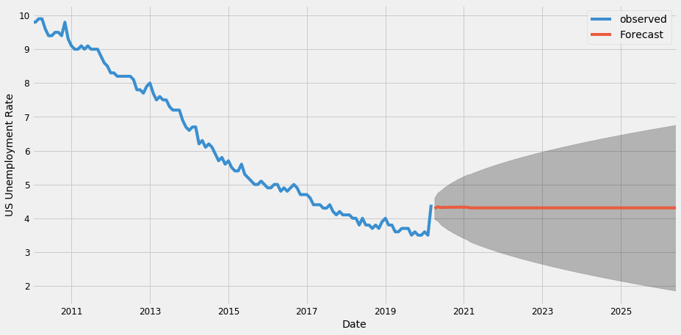
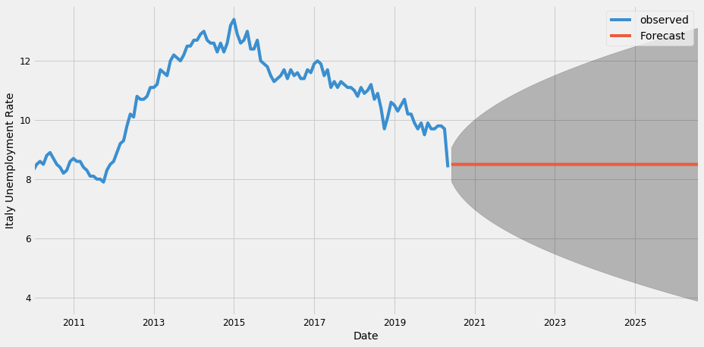
ARIMA Forecasting - Unemployment Data
US Unemployment Rate
Italy Unemployment Rate
‹#›

Slide 19
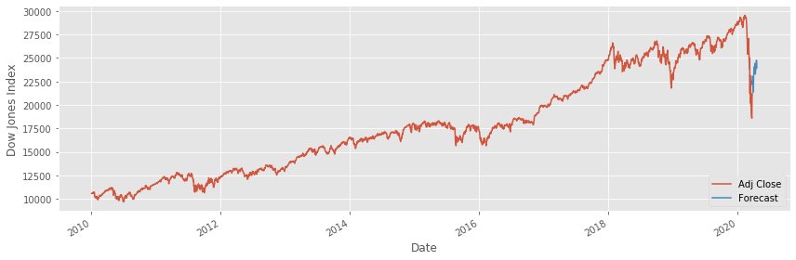
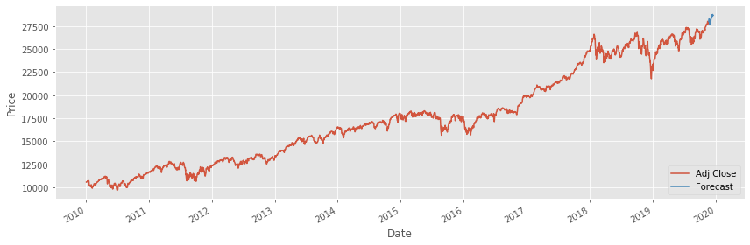
Linear Regression - Dow Jones Stock Index
Prediction with 2020 data
Prediction without 2020 data
‹#›

Slide 20

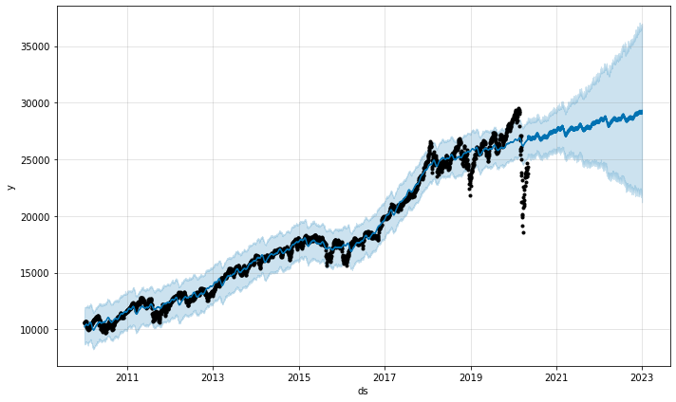
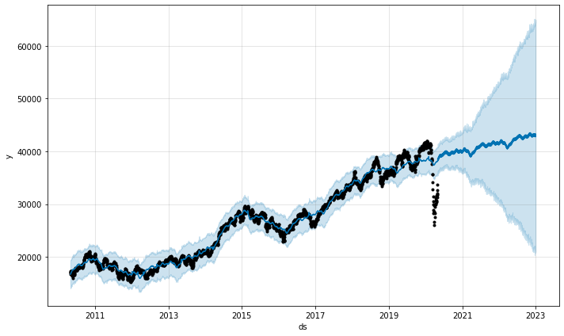
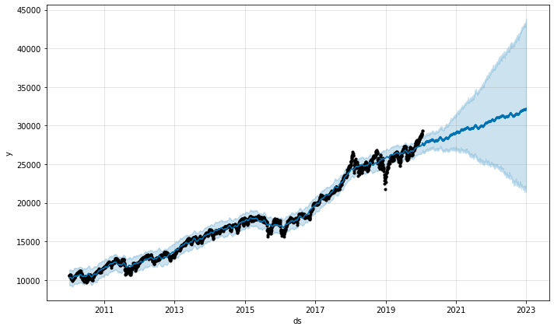
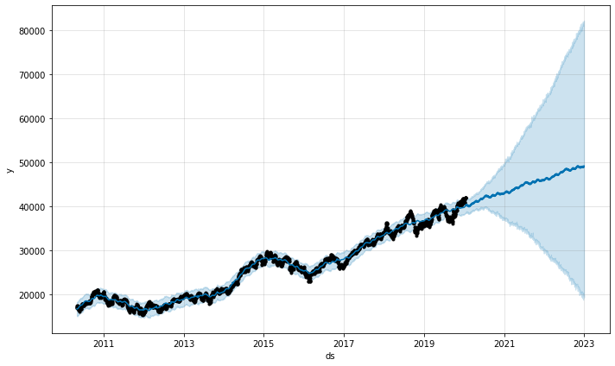
Stock Index Prediction For US and India
US DJI Stock Index
India BSE Stock Index
With COVID-19
End of 2020: 5.33%
End of 2021: 7.45%
End of 2022: 9.07%
End of 2020: 7.06%
End of 2021: 9.90%
End of 2022: 11.95%
W/O COVID-19
‹#›

Slide 21
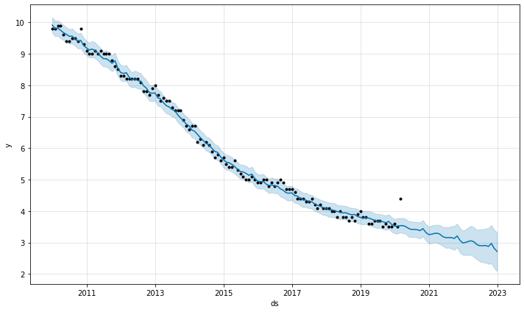
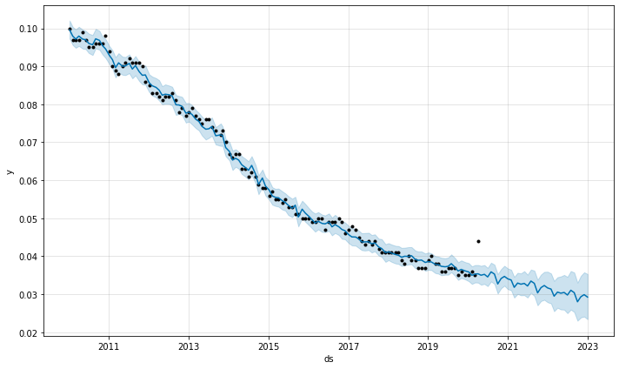
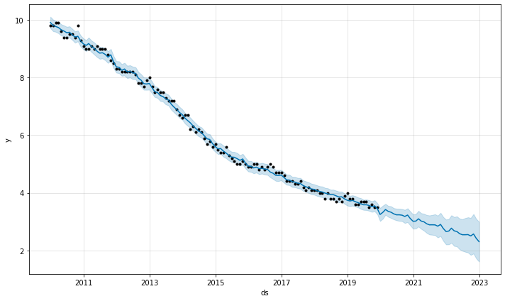
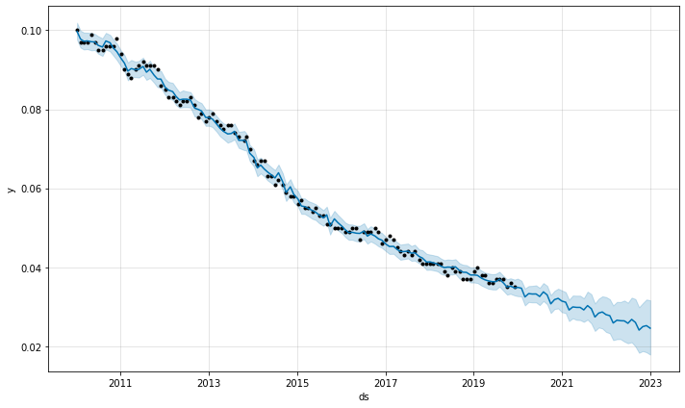
Unemployment Rate Prediction with Trend
US
India
With COVID19
End of 2020: 0.243%
End of 2021: 0.330%
End of 2022: 0.416%
Avg % Diff: 0.289%
End of 2020: 0.261%
End of 2021: 0.363%
End of 2022: 0.465%
Avg % Diff: 0.324%
W/O COVID19
‹#›

Slide 22
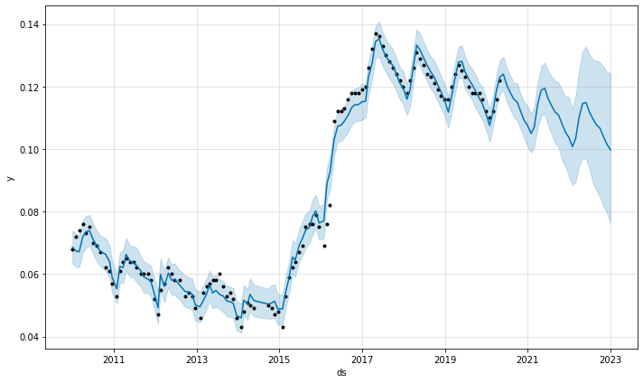
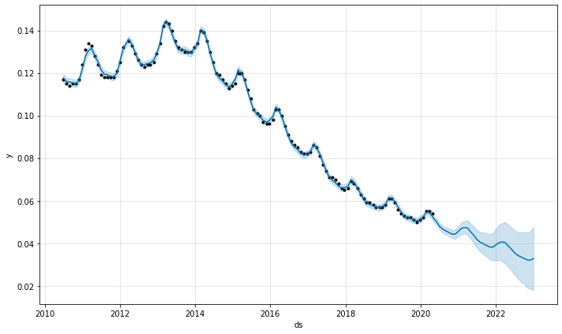
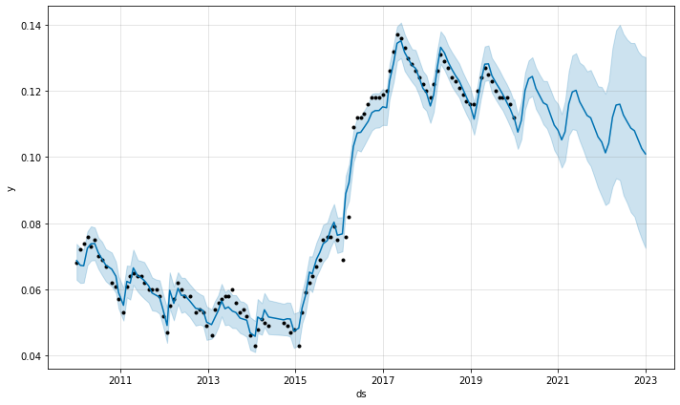
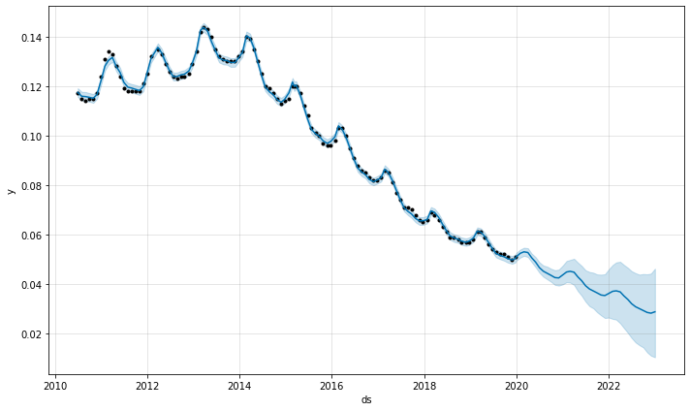
Unemployment Rate Prediction with Seasonal Variation
Brazil
Poland
With COVID19
End of 2020: 0.189%
End of 2021: 0.294%
End of 2022: 0.400%
Avg % Diff: 0.265%
W/O COVID19
End of 2020: 0.064%
End of 2021: 0.092%
End of 2022: 0.120%
Avg % Diff: 0.085%
‹#›

Slide 23
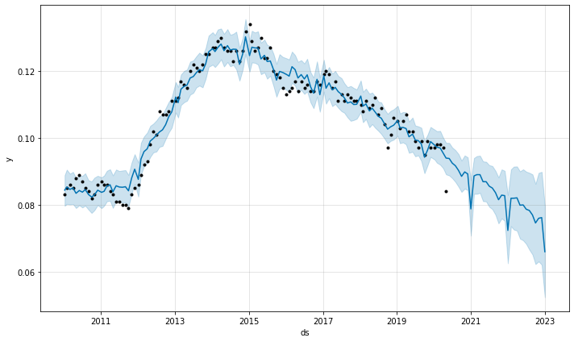
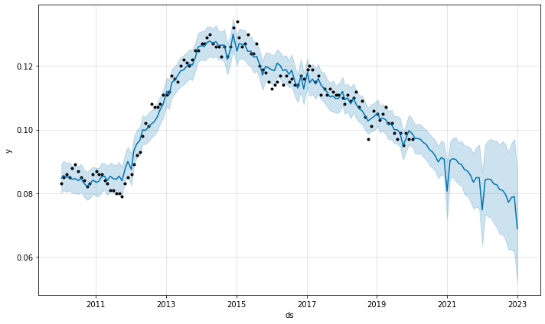
Unemployment Rate Prediction - Special Case
Italy
COVID19 Has Positive Impact on Italy
Drop the Unemployment Rate
With COVID19
End of 2020: -0.188%
End of 2021: -0.241%
End of 2022: -0.294%
Avg % Diff: 0.209%
W/O COVID19
‹#›

Slide 24
Cluster ID | Country | Characteristic
0 | India | High unemp, Low gdp
1 | Poland United States | Low unemp, High gdp
2 | Brazil Italy | Med unemp, Med gdp
To Wrap Up
Clustering
Sanity Check, Removed some Outliers
Data Compression, PCA
K-Means Clustering and Hierarchical Clustering
Prediction
Sanity Check
Unemployment Rate Prediction, ARIMA & FB Prophet Model
For most Countries, COVID19 has negative impact. Italy is a special case.
Stock Index Prediction, LR & FB Prophet Model
For US (DJI) and India(BSE), Stock Index are negatively impacted by COVID19.
‹#›

Slide 25
Thank You!
Any Questions?
‹#›

